Slide 1
Functional Dependency

Slide 2
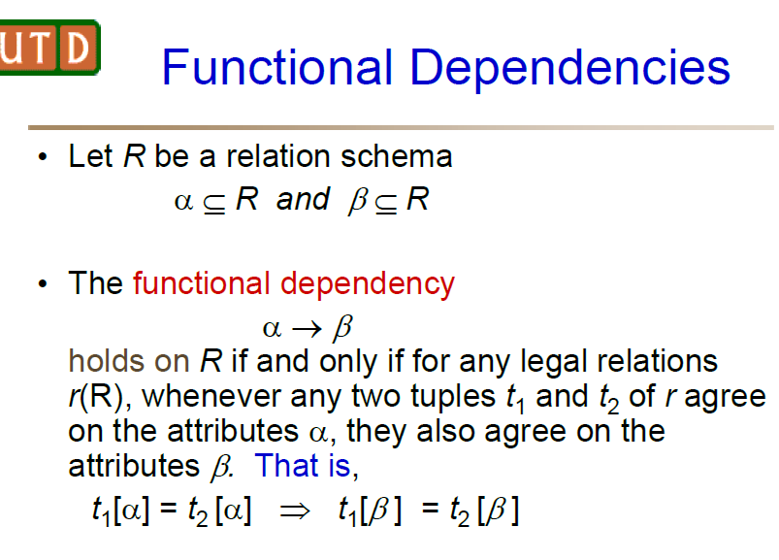

Slide 3
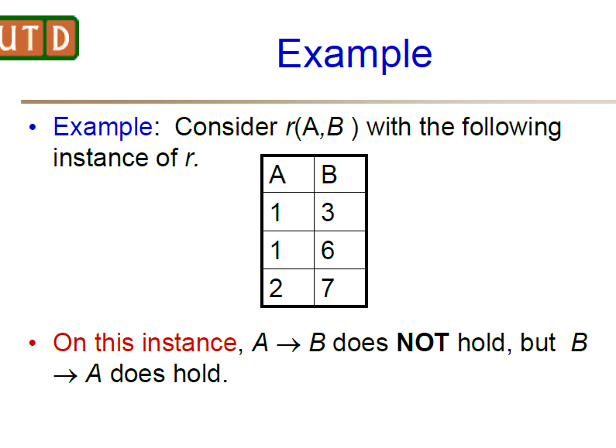

Slide 4
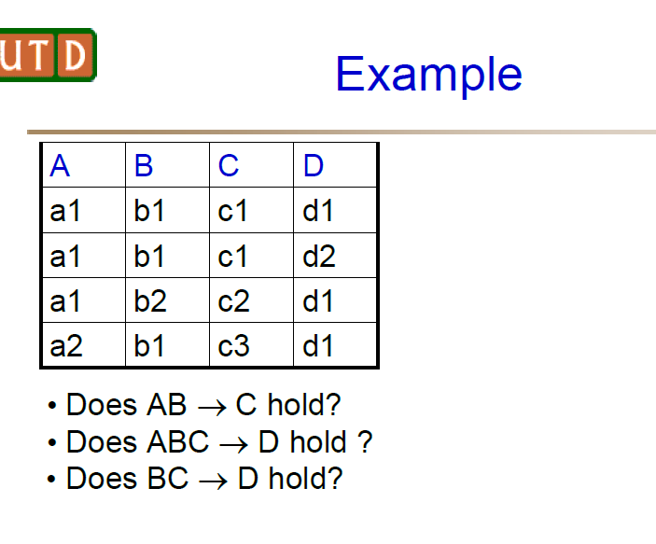

Slide 5
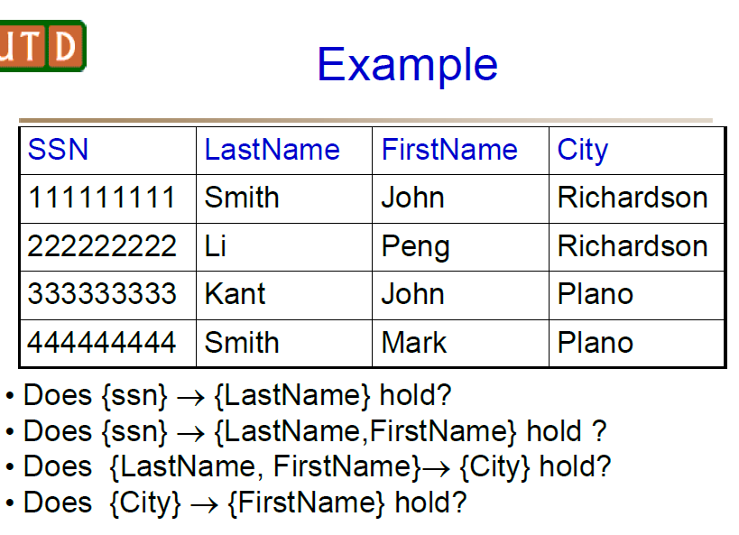

Slide 6
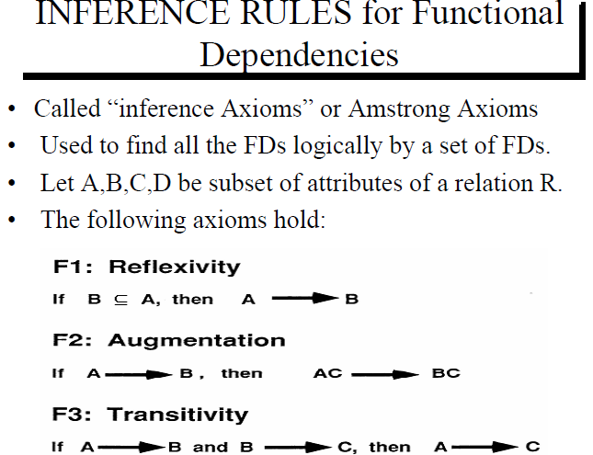

Slide 7
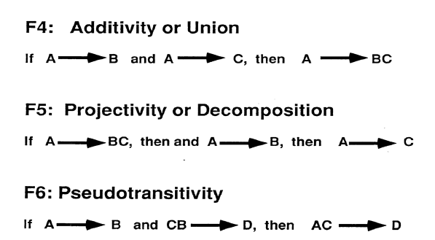

Slide 8
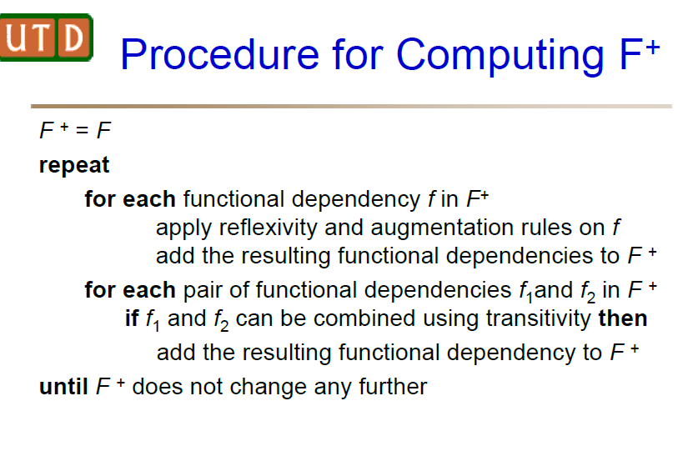

Slide 9
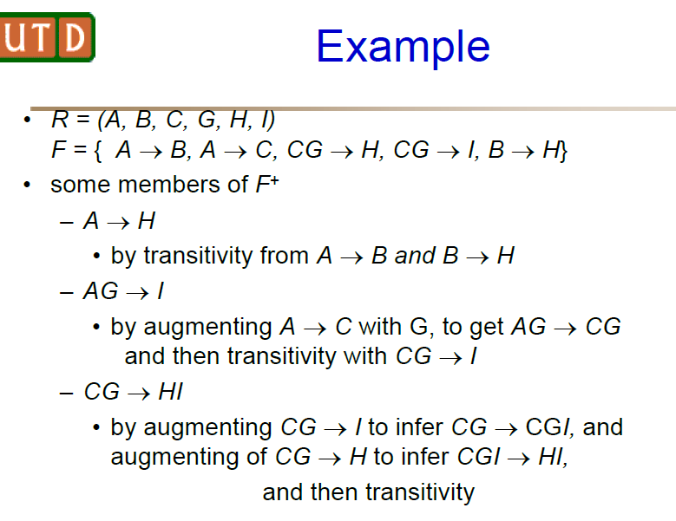

Slide 10
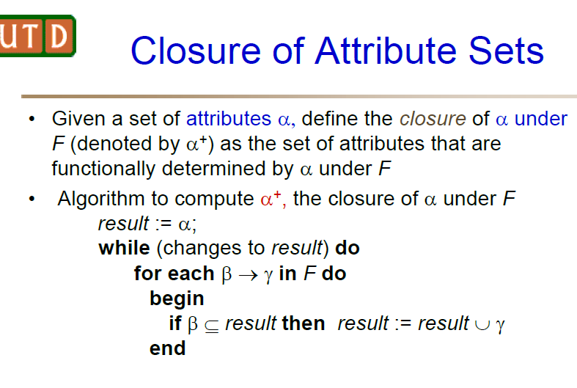

Slide 11
Example - 1
Order Relation
Consider the following relation:
Order(Product_Id, Product_Name, Customer_Id, Customer_Name, Order_Date,Item_Price, Amount, VAT, Gross_Total, Net_Total)
Assumptions:
The sales tax (VAT) value can vary from product to product (e.g. 8% for books, 16% for luxury items).
The gross total is the net total price plus the sales tax.
Customer orders on the same day are combined. We only have one order per customer and per day.
Properties do not change over time – everything is “write-once”.

Slide 12
Determine all functional dependencies of the relation Order.
Solution:
Product_Id→Product_Name,Item_Price,VAT
Customer_Id→Customer_Name
Product_Id,Customer_Id,Order_Date→Amount
Item_Price,Amount→Net_Total
Net_Total,V AT→Gross_Total
Note: If the product/customer names are unique, one could also consider the following functional dependencies:
Product_Name→Product_Id
Customer_Name→Customer_Id
Note:Because of the correlation between Net_Total, VAT and Gross_Total, one could also consider the following functional dependencies:
Gross_Total,V AT→Net_Total
Gross_Total,Net_Total→V AT

Slide 13
Find all the candidate keys.
Solution:
{Product_Id,Customer_Id,Date}
Note: If product/customer names are unique, we have the following additional key candidates:
{Product_Id,Customer_Name,Date}
{Product_Name,Customer_Name,Date}
{Product_Name,Customer_Id,Date}

Slide 14
Algorithm for finding the closure of an attribute
result := A;
while (changes to result) do
for each functional dependency B → C in F do
begin
if B ⊆ result then
result := result ∪ C;
end

Slide 15
Example - 1
R = (A, B, C)
Functional dependencies F = {A → B, B → C}.
Find the attribute closure of attribute A?
Solution:
A+ ={A}
A→ B = A+ ={AB}
B→ C= A+ ={ABC}
A⁺ includes all the attributes of relation R.
A is one of the keys of the relation R.

Slide 16
Example - 2
R(A, B, C, D, E, F)
FD: {AB → C, BC → AD, D → E, CF → B}
Finding (AB)⁺
result = AB
As AB → C, C can be included with the result. Hence, result = AB U C = ABC.
BC → AD, Result = ABC U AD = ABCD
D → E, Result = ABCD U E = ABCDE.
F cannot be identified by any of these FDs.
Hence, the solution is AB is not the key for R.
Try Finding (ABF)⁺

Slide 17
Example - 3
R(A,B,C,D)
FD: BC → A, AD → B, CD → B, AC → D.
Attribute Closure:
(BC)+ = BC → A ;AC → D ; = {ABCD}
(CD)+ = CD → B; BC → A; = {ABCD}
(AC)+ = AC → D; AD → B; or CD → B = {ABCD}

Slide 18
Example – 4
Closures and Keys
Given a relation R(A,B,C,D,E,F,G) with the following five functional dependencies F:
(1)A→BC (2)E→CF (3)B→E (4)CD→EF (5)A→G
Find the closure of A
Solution:
(6)A→B (because (1))
(7)A→C (because (1))
(8)A→E (transitive property (6) and (3))
(9)A→CF (transitive property from (8) and (2))
(10)A→G (because (5))Therefore,{A}+ ={A,B,C,E,F,G}

Slide 19
Find a candidate key for R
Solution:{A,D}
What is the closure of G?
Solution: {G}+ ={G}

Slide 20
Example - 5
R ( A , B , C , D , E , F , G )
FD: A → BC, BC → DE, D → F, CF → G
Solution
A⁺ = { A }
= { A , B , C } ( Using A → BC )
= { A , B , C , D , E } ( Using BC → DE )
= { A , B , C , D , E , F } ( Using D → F )
= { A , B , C , D , E , F , G } ( Using CF → G )
Thus, A⁺ = { A , B , C , D , E , F , G }

Slide 21
Closure of attribute D-
D⁺ = { D }
= { D , F } ( Using D → F )
Thus, D⁺ = { D , F }
Closure of attribute set {B, C}-
{ B , C }⁺= { B , C }
= { B , C , D , E } ( Using BC → DE )
= { B , C , D , E , F } ( Using D → F )
= { B , C , D , E , F , G } ( Using CF → G )
Thus, { B , C }⁺ = { B , C , D , E , F , G }

Slide 22
Alternate Solution for Finding the KEY

Slide 23
Finding a Key K for R
Input: A relation schema R and a set of functional dependencies F on the attributes of R.
Set K := R;
2. For each attribute A in K
{
compute (K – A)⁺ with respect to F;
if (K – A)⁺ contains all the attributes in R,
then set K := K – {A};
}

Slide 24
Finding a key?
Consider the following relation:
R(A, B, C, D, E)
Suppose that the following dependencies exist
A → C, C → D, B → E.
Find out a key of R?

Slide 25
Solution
Initialize K := ABCDE.
Suppose that we remove A from ABCDE and compute (BCDE)⁺.
We find that (BCDE)⁺ = (BCDE) ≠ R and hence A cannot be
removed from ABCDE.
Suppose that we remove B from ABCDE and compute (ACDE)⁺.
We find that (ACDE)⁺ = ACDE ≠ R and hence B too cannot be
removed from ABCDE.
Suppose that we remove C from ABCDE and compute (ABDE)⁺.
We find that (ABDE)⁺= ABDEC = R and hence C can be
removed from ABCDE. So K is now reduced to ABDE.

Slide 26
Solution (continued)
Suppose that we remove D from ABDE and
compute (ABE)⁺.
We find that (ABE)⁺ = ABECD = R and hence D can be removed from ABDE. So K is reduced to ABE.
Suppose that we remove E from ABE and compute
(AB)⁺.
We find that (AB)⁺ = ABCDE = R and hence E can be
removed from ABE.
So a key of the relation R is AB.

Slide 27
Choosing the Normal Forms

Slide 28
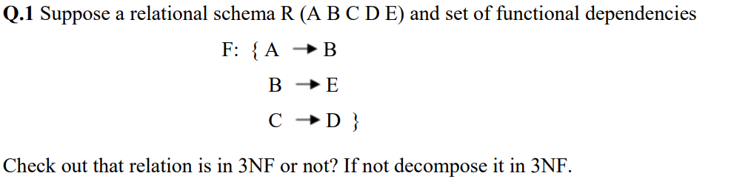
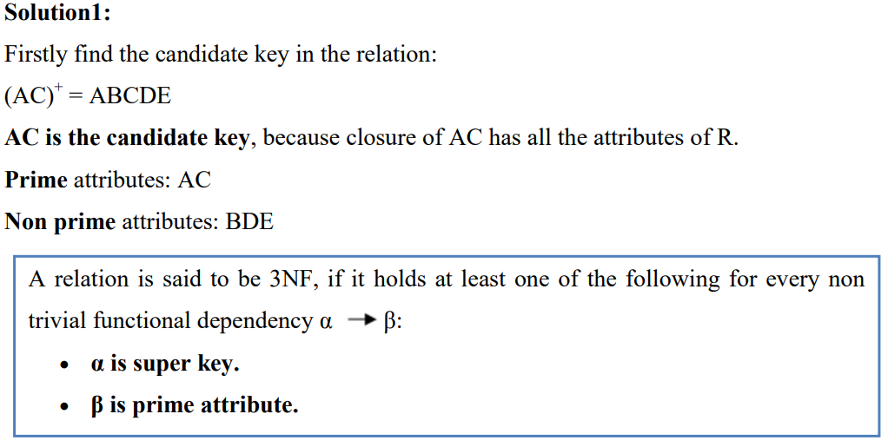

Slide 29
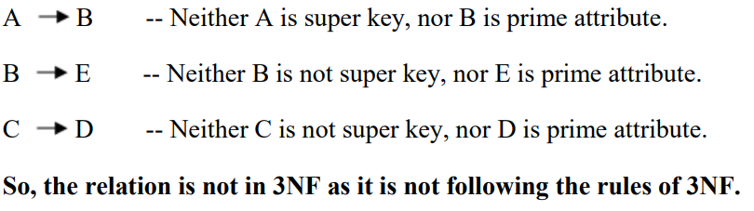
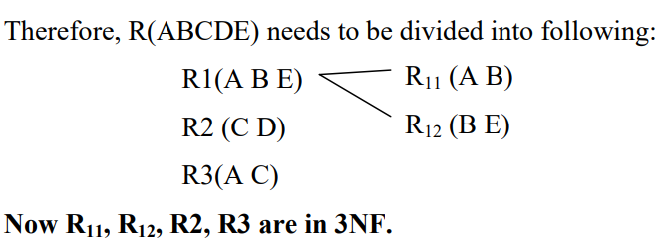

Slide 30
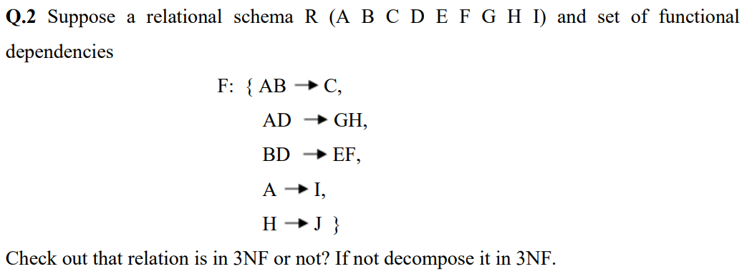
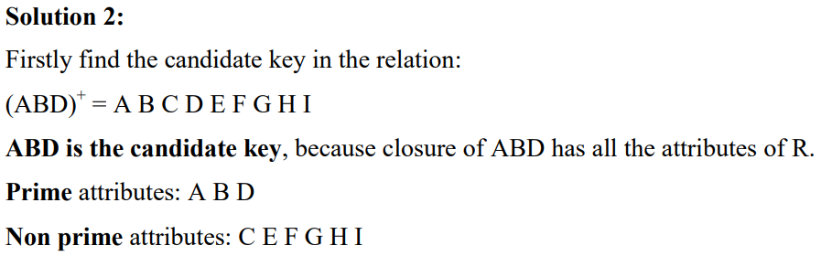

Slide 31
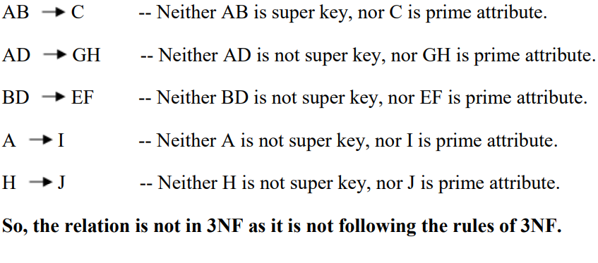
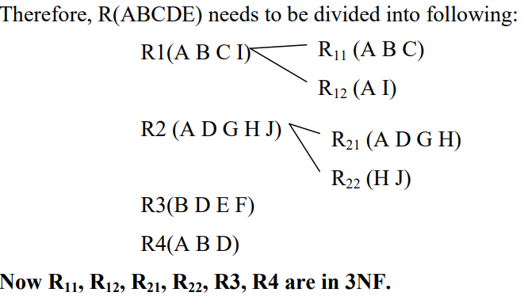

Slide 32
Let R(P,Q,R,S,T,U,V,W,X)
FD={PQ→R, QS→TU, PS→VW, P→X}
Check that in which normal form the relation is present now.
Solution:
KEY:PQS
Answer: 1NF

Slide 33
Let R(X,Y,Z,W,P), FD={X→ Y, Y→P, Z→W}
Check that the table R is in 3NF. Otherwise, decompose the table in 3NF.
Solution:
KEY: XZ
Lets check the first FD X→Y, here X is not superkey and Y is not prime attribute. Hence it is not 3NF. If one of the FD is failed to be satisifed, then entire relation R is not in 3NF.
Now, it is important to decompose the table R in sub tables:
R1(X,Y)
R2(Y,P)
R3(Z,W)
R4(X,Z)

Slide 34
Relation R(P,Q,R,S,T,U,V,W,X,Y)
FD={PQ→R, P→ST, Q→U, U→VW, S→XY}
Check for 3NF and if not decompose it.
Solution:
KEY: PQ
Now check the first FD PQ→ R, and check that PQ is a super key. YES. It is in 3NF.
Now check the second FD, P→ST, and here P is not a super key and ST is not a prime attribute. So it is not in 3NF. Now decompose the relation R into following:
R1(P,S,T)
R2(Q,U)
R3(U,V,W)
R4(S,X,Y)
R5(P,Q,R)

Slide 35
Consider a relation R(A, B, C) with FD's AB → C, AC → B, BC → A. Determine all the keys of relation R. Is the relation R in BCNF?
Solution:
Keys are AB, AC, and BC.
Is R in BCNF?
Requirements: R should be in 2NF, 3NF, and every determinant must be a candidate key.
From the set of functional dependencies given, we observe the following;
No partial key dependencies. So, R is in 2NF.
No transitive dependencies. So, R is in 3NF.
Every determinant (AB, BC, AC) is a candidate key. Hence, R is in BCNF as well.

Slide 36
Consider a relation R(A, B, C, D) with FD's AB → C, AC → B, BC → A, B → D.
Is the relation R in BCNF?
Solution:
The table is in 1NF.
Lets check for 2NF:
R is not in 2NF. We need to decompose R into the following relations:
R1(A, B, C) and R2(B, D).
R1 and R2 do not have partial key dependencies, and transitive dependencies. Hence, both are in 2NF and 3NF.
Now Check for BCNF:
The determinants are the keys in both the relations. Hence, R1 and R2 are in BCNF.

